Slide 1

4
INTEGRALS

Slide 2
Contents
4.1 Areas and Distance
4.2 The Define Integral
4.3 Evaluating Define Integrals
4.4 The Fundamental Theorem of Calculus
4.5 The Substitution Rule

Slide 3
INTEGRALS
4.1
Areas and Distances
In this section, we will learn that:
We get the same special type of limit in trying to find
the area under a curve or a distance traveled.
Notes:
Area under a curve as the limit of a sum areas of thin rectangles.
Distance in terms of the velocity curve.
Notation of Riemann Sum.
Approximation of areas using rectangles (the right hand, left hand and midpoint sums).

Slide 4
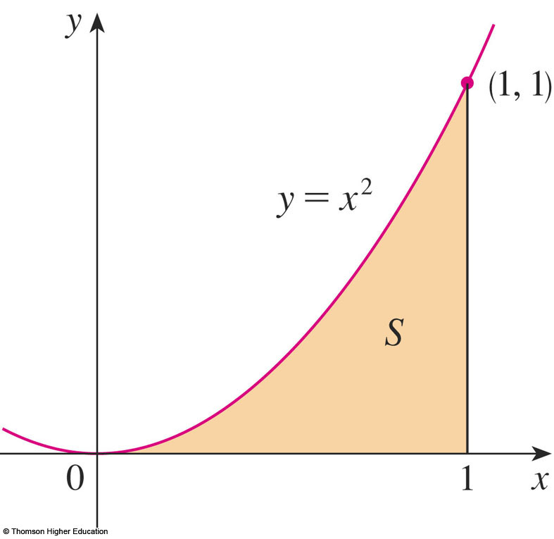
AREA PROBLEM
We begin by attempting to solve the area problem:
Find the area of the region S that lies under the curve y = f(x) from a to b.

Slide 5
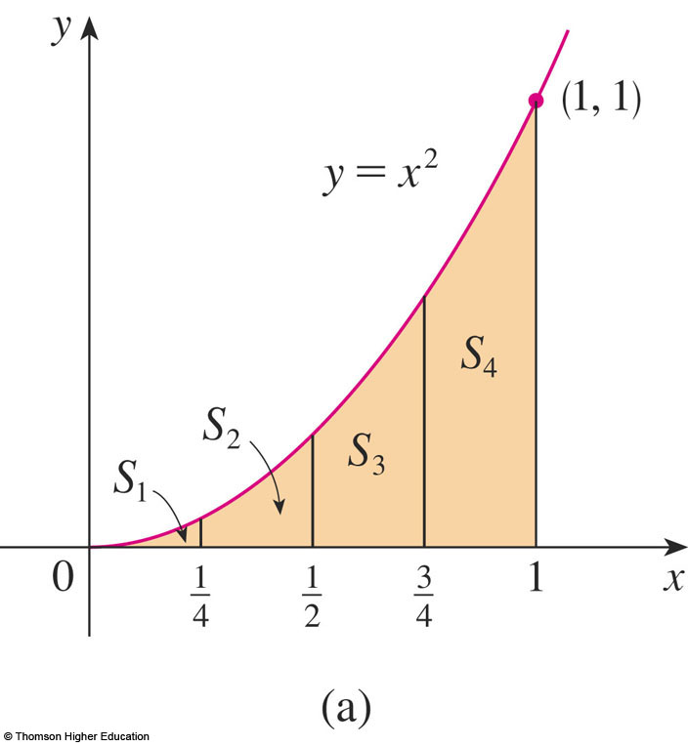
AREA PROBLEM
Example 1
Suppose we divide S into four strips S₁, S₂, S₃, and S₄ by drawing the vertical lines x = ¼, x = ½, and
x = ¾.

Slide 6
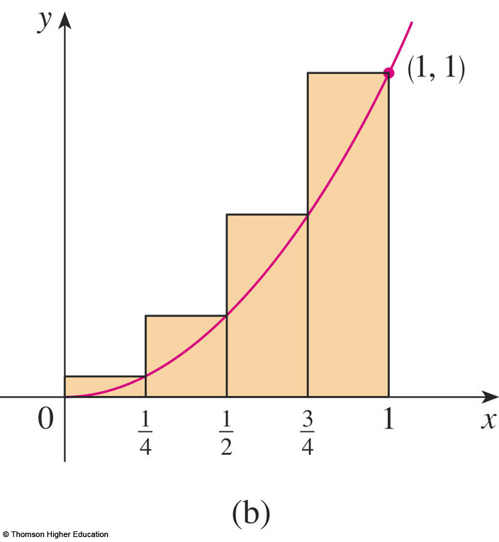
AREA PROBLEM
Example 1
The heights of these rectangles are the values of the function f(x) = x² at the right endpoints of the subintervals
[0, ¼],[¼, ½], [½, ¾],
and [¾, 1].

Slide 7
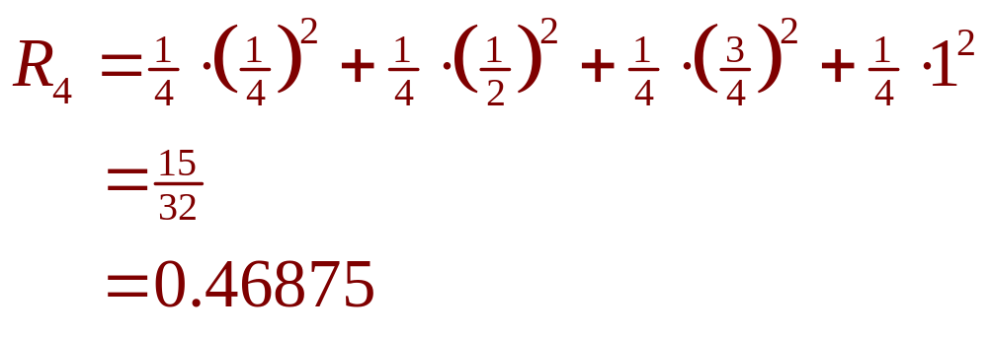
AREA PROBLEM
Example 1
Each rectangle has width ¼ and the heights are (¼)², (½)², (¾)², and 1².

Slide 8
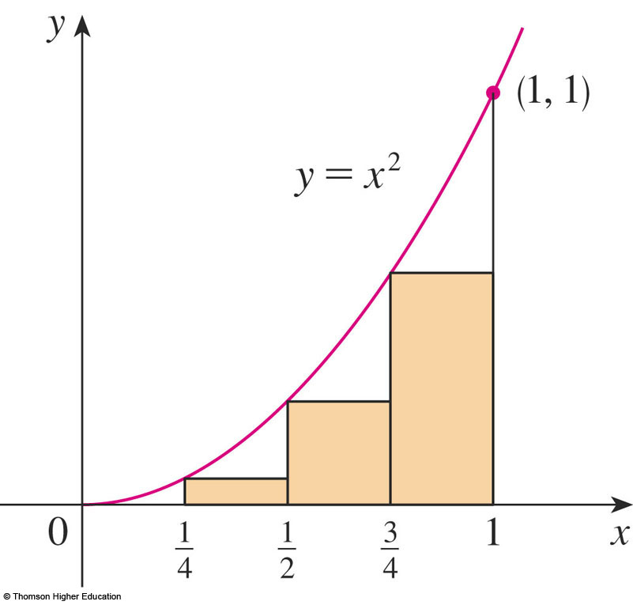
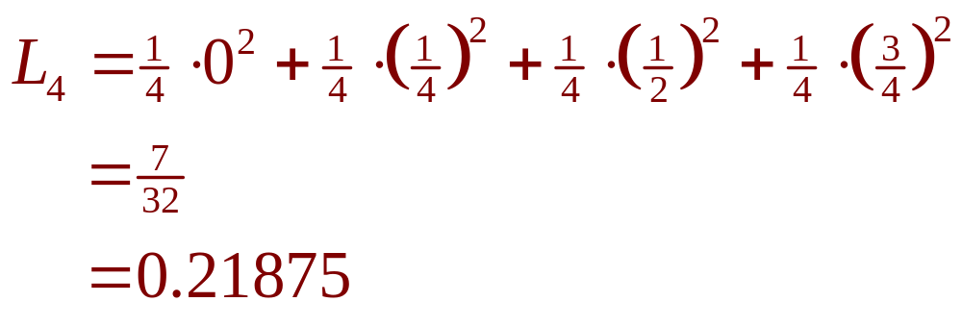
AREA PROBLEM
Example 1
Here, the heights are the values of f at the left endpoints of the subintervals.

Slide 9
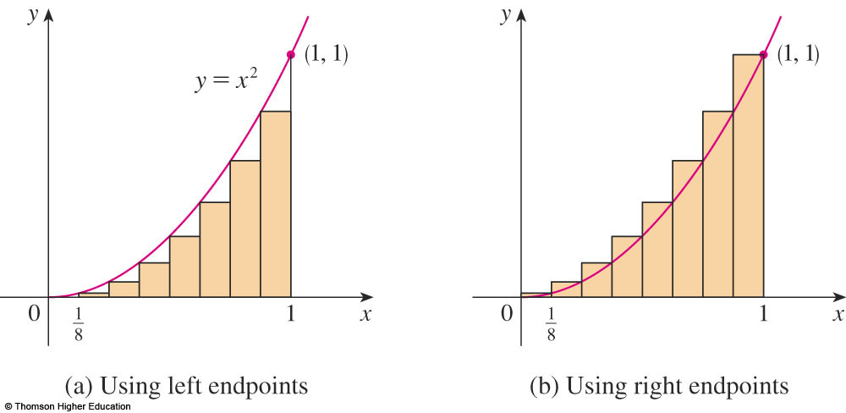
AREA PROBLEM
Example 1
The figure shows what happens when we divide the region S into eight strips of equal width.
0.2734375 < A < 0.3984375

Slide 10
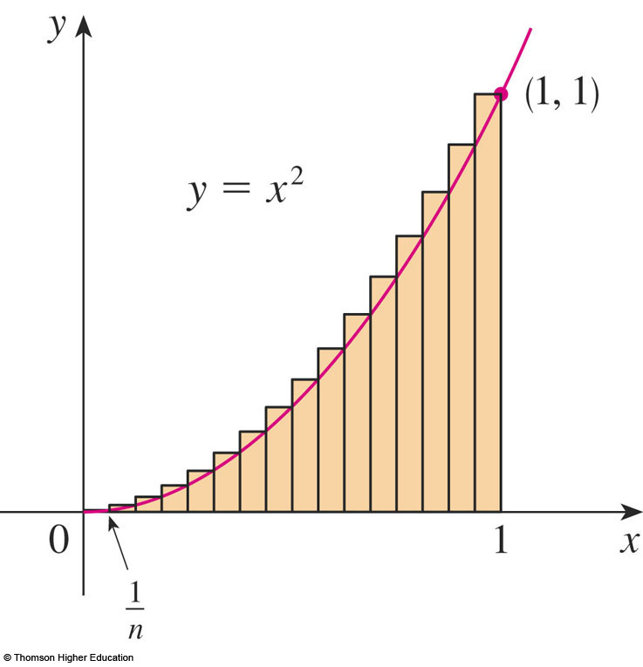
AREA PROBLEM
Example 2
R_{n} is the sum of the areas of the n rectangles.
  Each rectangle has width
  1/n and the heights are
  the values of the function
  f(x) = x² at the points
  1/n, 2/n, 3/n, …, n/n.
  That is, the heights are
  (1/n)², (2/n)², (3/n)², …,
  (n/n)².

Slide 11
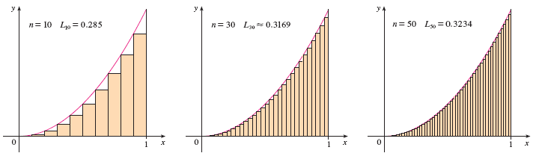
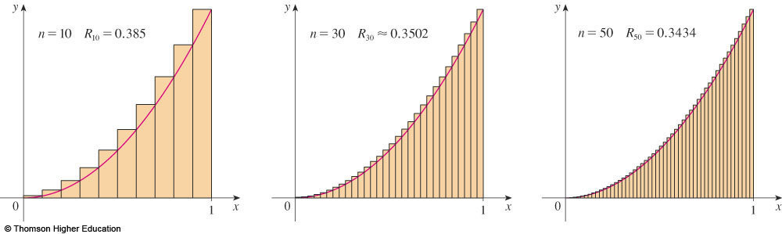
AREA PROBLEM
© Thomson Higher Education

Slide 12
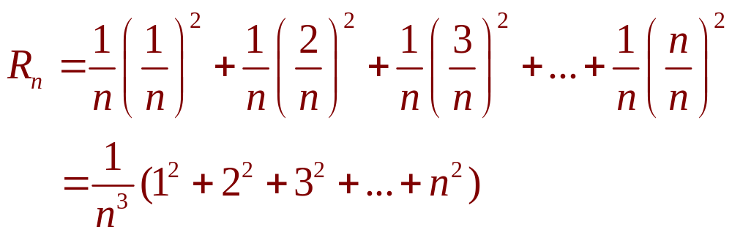
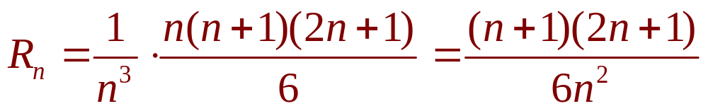
AREA PROBLEM
Example 2
Thus,

Slide 13
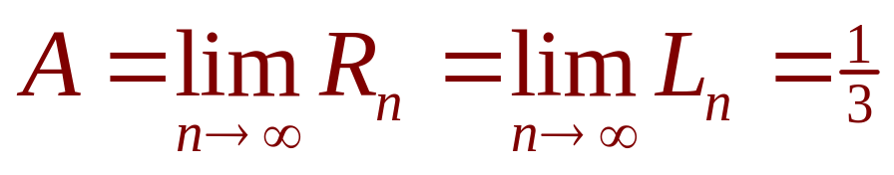
AREA PROBLEM
Thus, we define the area A to be the limit of the sums of the areas of the approximating rectangles, that is,

Slide 14
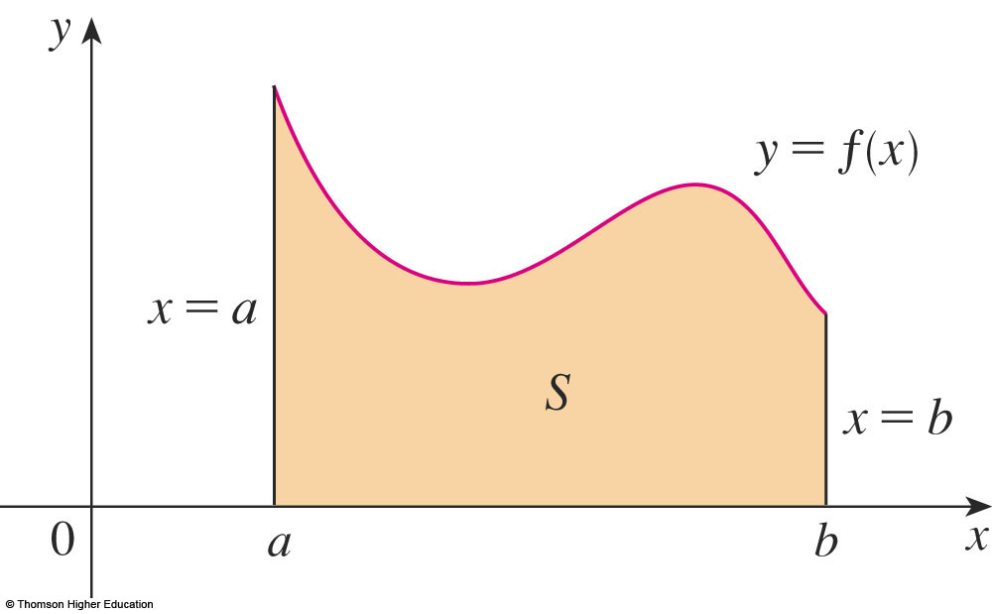
AREA PROBLEM
Let’s apply the idea of Examples 1 and 2
to the more general region S of the earlier figure.

Slide 15
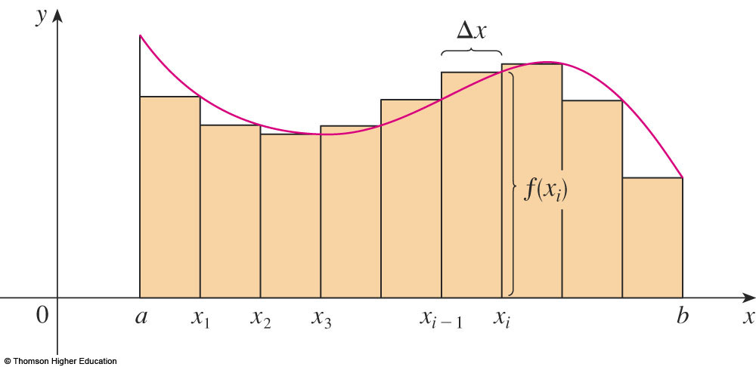
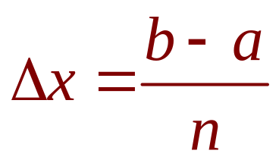
AREA PROBLEM
What we think of intuitively as the area of S is approximated by the sum of the areas of these rectangles:
R_{n} = f(x₁) ∆x + f(x₂) ∆x + … + f(x_{n}) ∆x

Slide 16
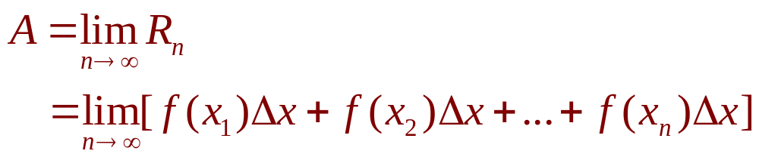
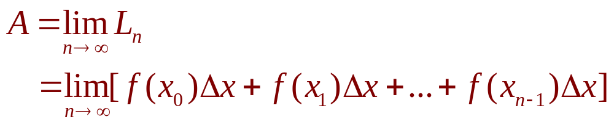
AREA PROBLEM
Definition 2
The area A of the region S that lies under the graph of the continuous function f is the limit of the sum of the areas of approximating rectangles:

Slide 17
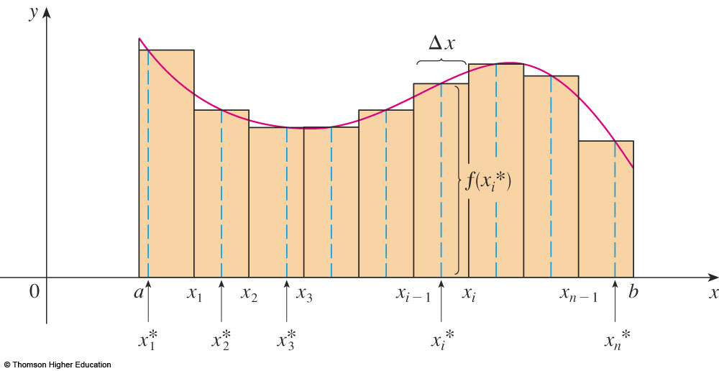
AREA PROBLEM
The figure shows approximating rectangles when the sample points are not chosen to be endpoints.
x_{i}* in the i ^{th} subinterval [x_{i - 1}, x_{i}]
(the sample points)
Notes:
The sample point such as left end point, right end point and midpoint.

Slide 18
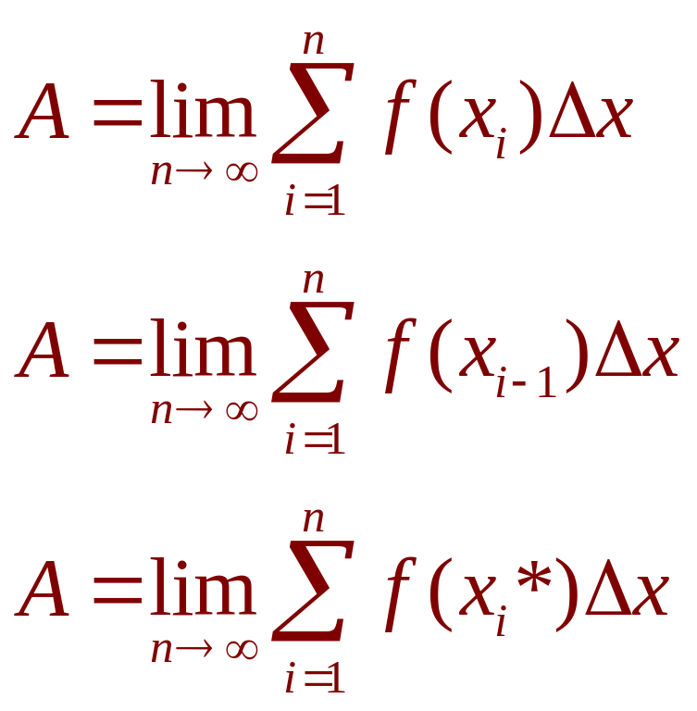
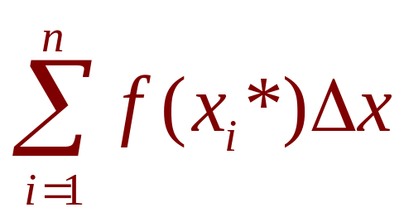
AREA PROBLEM
Hence,
The sum
is called a Riemann sum.

Slide 19
Evaluating the Riemann sum of the function f(x)= x-1/x (1<=x<=2) ,
with four subintervals. The sample points are the right endpoints.
Answer:

Slide 20
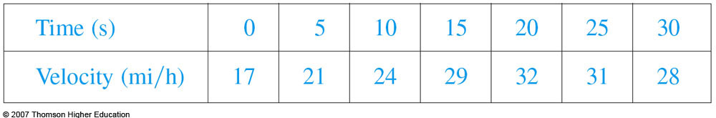
DISTANCE PROBLEM
Example 4
Suppose the odometer on our car is broken and we want to estimate the distance driven over a 30-second time interval.
We take speedometer readings every five seconds and record them in this table.
Notes:
Actual distance traveled by approximating the area under the velocity curve.

Slide 21
DISTANCE PROBLEM
Example 4
If we take the velocity during that time interval to be the initial velocity (25 ft/s), then we obtain the approximate distance traveled during the first five seconds:
25 ft/s x 5 s = 125 ft

Slide 22
DISTANCE PROBLEM
Example 4
If we had wanted a more accurate estimate, we could have taken velocity readings every two seconds, or even every second.

Slide 23
DISTANCE PROBLEM
In general, suppose an object moves with velocity
v = f(t)
where a ≤ t ≤ b and f(t) ≥ 0.
We take velocity readings at times
t₀(= a), t₁, t₂, …., t_{n}(= b)
so that the velocity is approximately constant on each subinterval.
  ∆t = (b – a)/n

Slide 24
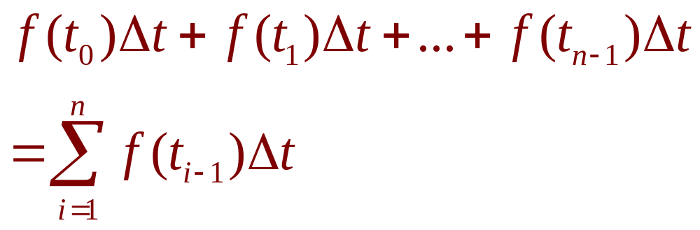
DISTANCE PROBLEM
Similarly, the distance traveled during the second time interval is about f(t₁)∆t and the total distance traveled during the time interval [a, b] is approximately

Slide 25
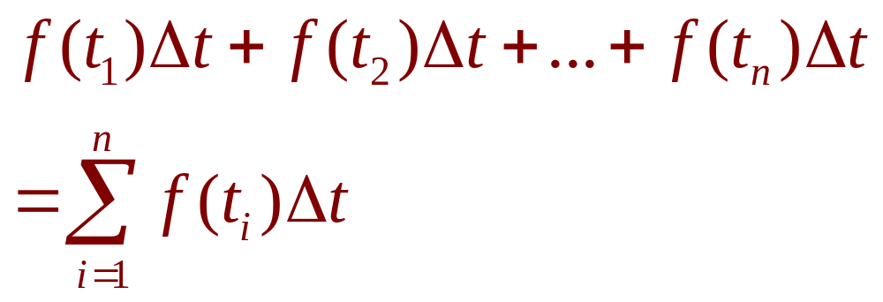
DISTANCE PROBLEM
If we use the velocity at right endpoints instead of left endpoints, our estimate for the total distance becomes:

Slide 26
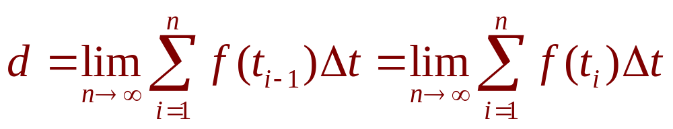
DISTANCE PROBLEM
Equation 5
So, it seems plausible that the exact distance d traveled is the limit of such expressions:
  We will see in Section 5.4 that this is indeed true.

Slide 27
INTEGRALS
4.2&4.3
The Definite Integral
In this section, we will learn about:
Integrals with limits that represent
a definite quantity.
Notes:
The precise definition of a definite integral.
The definition of an integrable function.
The concept of “area” and “signed area”.

Slide 28
DEFINITE INTEGRAL
Definition 2
If f is a function defined for a ≤ x ≤ b,
we divide the interval [a, b] into n subintervals of equal width ∆x = (b – a)/n.
  We let x₀(= a), x₁, x₂, …, x_{n}(= b) be the endpoints
  of these subintervals.
  We let x₁*, x₂*,…., x_{n}* be any sample points in
  these subintervals, so x_{i}* lies in the i ^{th} subinterval.

Slide 29
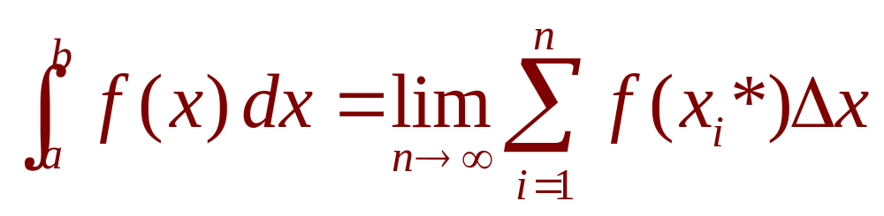
DEFINITE INTEGRAL
Definition 2
Then, the definite integral of f from a to b is
provided that this limit exists.
☞ If it does exist, we say f is integrable on [a, b].
☞ The symbol ∫ was introduced by Leibniz and is called an integral sign.

Slide 30
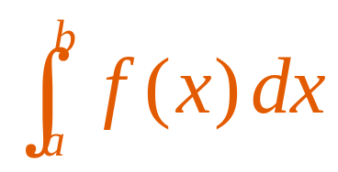
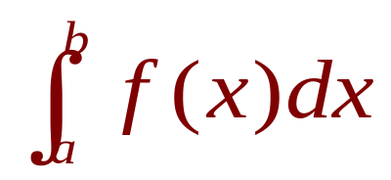
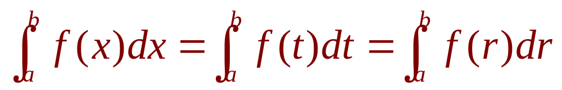
DEFINITE INTEGRAL
Note 2
The definite integral is a number.
It does not depend on x.
In fact, we could use any letter in place of x without changing the value of the integral:

Slide 31
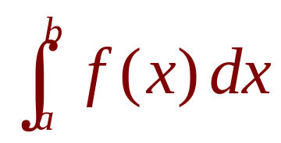
INTEGRABLE FUNCTIONS
Theorem 3
If f is continuous on [a, b], or if f has only a finite number of jump discontinuities, then f is integrable on [a, b].
That is, the definite integral exists.

Slide 32
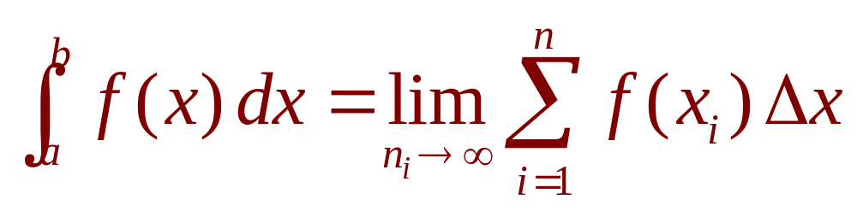
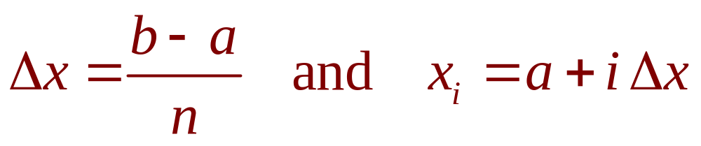
INTEGRABLE FUNCTIONS
Theorem 4
If f is integrable on [a, b], then
where

Slide 33
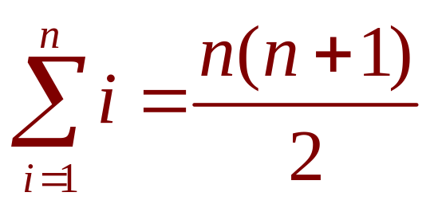
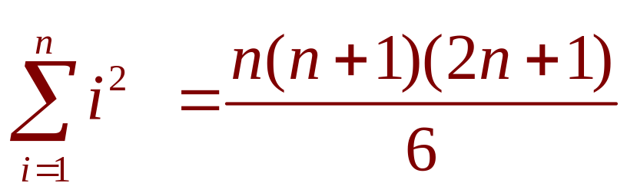
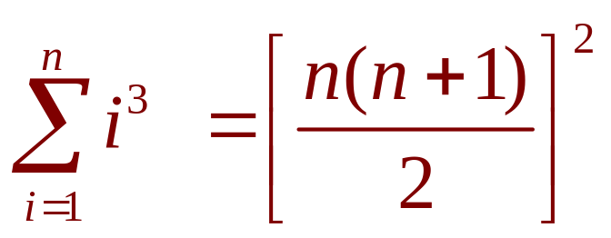
EVALUATING INTEGRALS
Equation 5,6,7
The following three equations give formulas for sums of powers of positive integers.

Slide 34
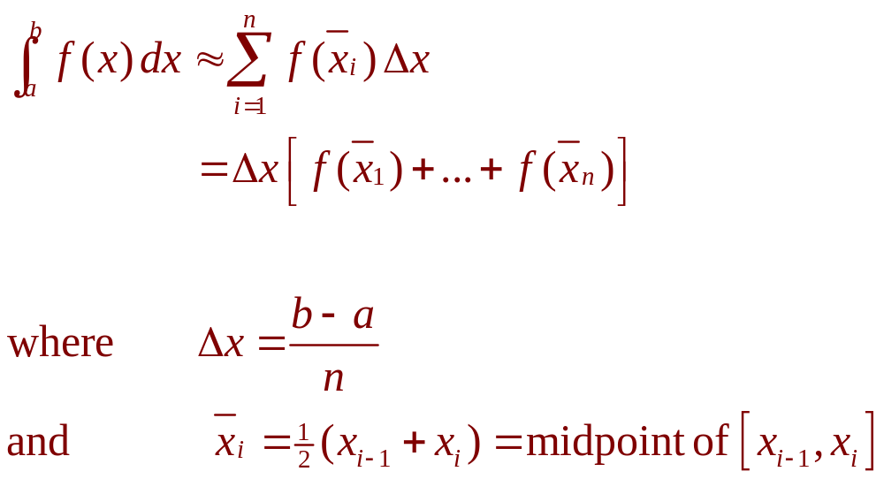
THE MIDPOINT RULE
Notes:
Riemann sum

Slide 35
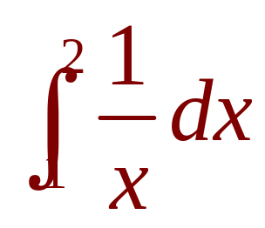
MIDPOINT RULE
Example 5
Use the Midpoint Rule with n = 5
to approximate
  The endpoints of the five subintervals
  are: 1, 1.2, 1.4, 1.6, 1.8, 2.0
  So, the midpoints are: 1.1, 1.3, 1.5, 1.7, 1.9

Slide 36
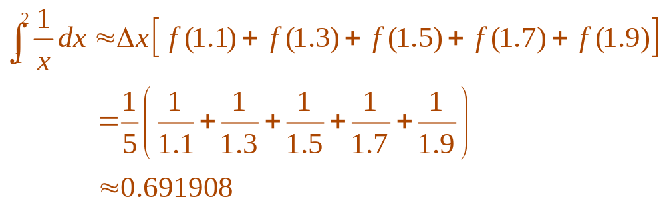
MIDPOINT RULE
Example 5
  The width of the subintervals is:
  ∆x = (2 - 1)/5 = 1/5
  So, the Midpoint Rule gives:

Slide 37
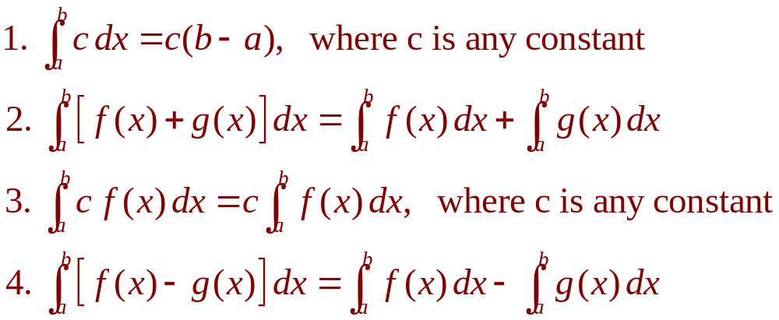
PROPERTIES OF THE INTEGRAL
We assume f and g are continuous functions.

Slide 38
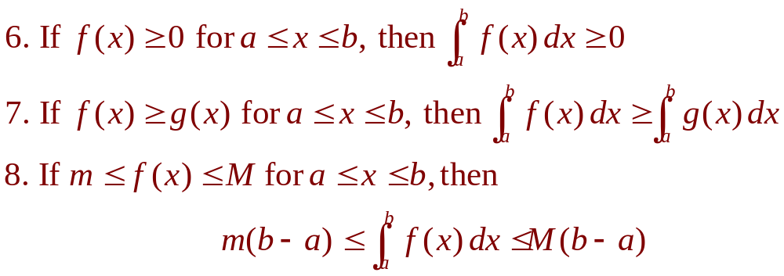
COMPARISON PROPERTIES OF THE INTEGRAL
These properties, in which we compare sizes of functions and sizes of integrals, are true only if a ≤ b.
Notes:
The geometric and comparison properties of definite integrals, developed as statements about area.

Slide 39
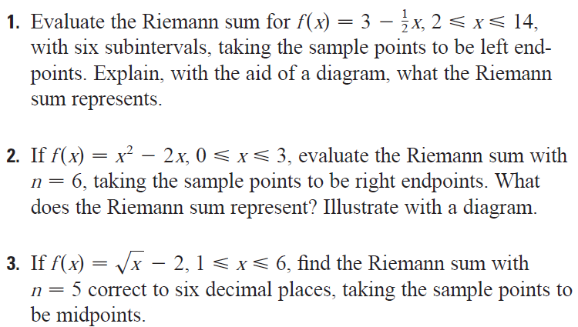
Notes:
1: -6; 2: 7/8; 3: -0.85

Slide 40

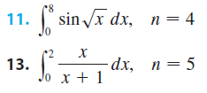


Slide 41
INTEGRALS
4.4
The Fundamental
Theorem of Calculus
In this section, we will learn about:
The Fundamental Theorem of Calculus
and its significance.
Notes:
Precise interpretations of both parts of the Fundamental Theorem of Calculus (FTC1 and FTC2).
When FTC2 can be used.

Slide 42
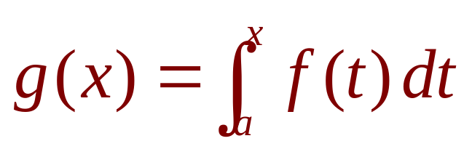
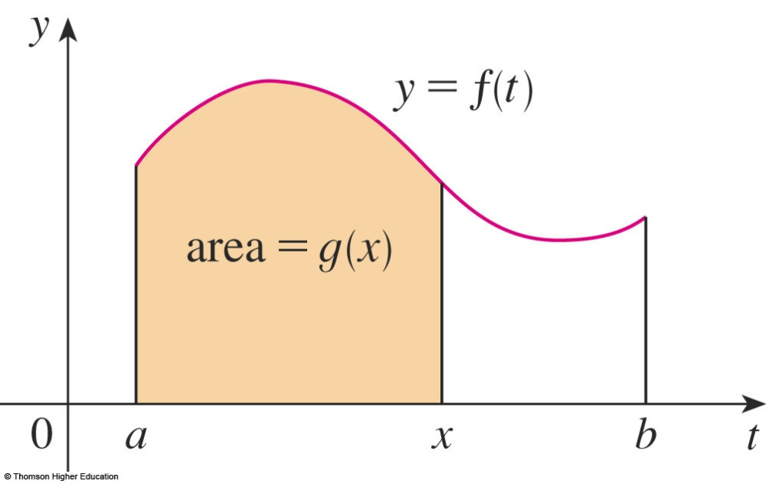
FTC
Equation 1
The first part of the FTC deals with functions defined by an equation of the form:
where f is a continuous function on [a, b] and x varies between a and b.
Notes:
The right-hand side is a function of x and not t.

Slide 43
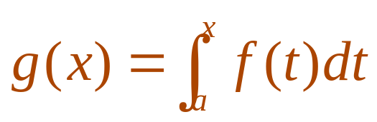

FTC
To see why this might be generally true, we consider a continuous function f with f(x) ≥ 0.
  Then, can be interpreted as
  the area under the graph of f from a to x.

Slide 44
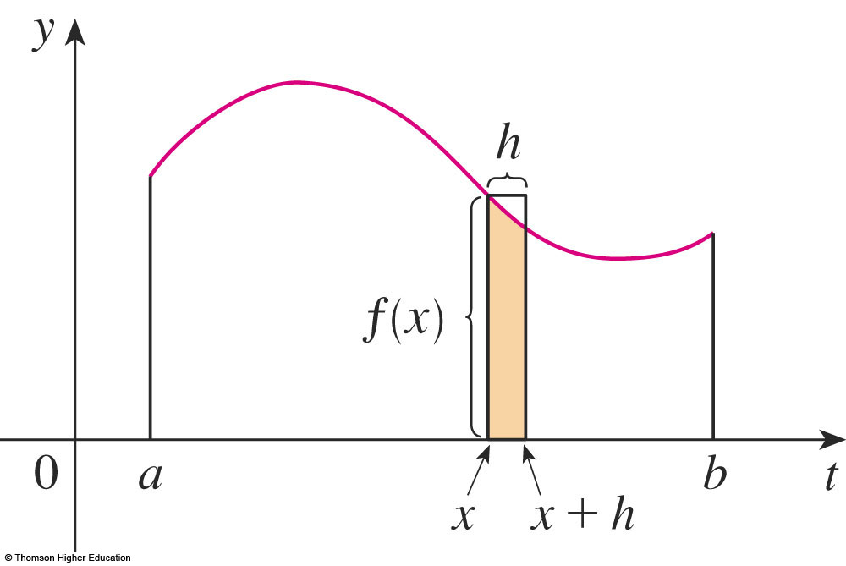
FTC
To compute g’(x) from the definition of derivative, we first observe that, for h > 0,
g(x + h) – g(x) is obtained by subtracting areas.
  It is the area
  under the graph
  of f from x to x + h
  (the gold area).

Slide 45
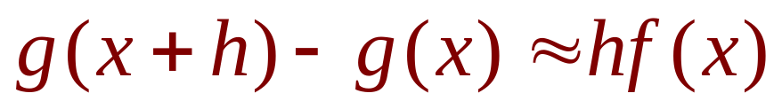
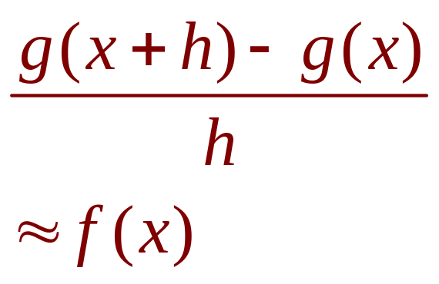
FTC
For small h, you can see that this area is approximately equal to the area of the rectangle with height f(x) and width h:
So,

Slide 46
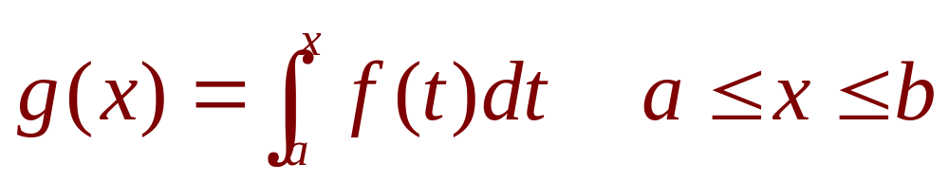
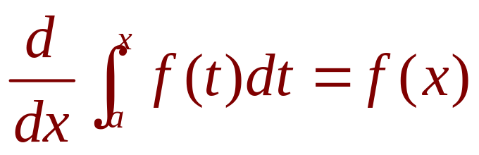
FTC1
If f is continuous on [a, b], then the function g defined by
is continuous on [a, b] and differentiable on (a, b), and g’(x) = f(x).
Using Leibniz notation for derivatives, we can write the FTC1 as
when f is continuous.
Notes:
For every a, g(x) is an anti derivative if f.

Slide 47

Generalization

Slide 48


If
Find g’(x)

Slide 49

FTC2
If f is continuous on [a, b], then
where F is any antiderivative of f, that is, a function such that F’ = f.
Notes:
The right-hand side is a constant.

Slide 50


NET CHANGE THEOREM
So, we can reformulate
as follows.
The integral of a rate of change is the net change:

Slide 51

NET CHANGE THEOREM
If the mass of a rod measured from the left end to a point x is m(x), then the linear density is ρ(x) = m’(x).
  So,
  is the mass of the segment of the rod
  that lies between x = a and x = b.
Notes:
The interpretation of the Fundamental Theorem of Calculus 2 as the total change of a rate fuction.

Slide 52

NET CHANGE THEOREM
If the rate of growth of a population is dn/dt, then
is the net change in population during the time period from t₁ to t₂.
  The population increases when births happen
  and decreases when deaths occur.
  The net change takes into account both births
  and deaths.

Slide 53

NET CHANGE THEOREM
Equation 2
If an object moves along a straight line
with position function s(t), then its velocity
is v(t) = s’(t).
  So,
  is the net change of position, or displacement,
  of the particle during the time period from t₁ to t₂.

Slide 54
NET CHANGE THEOREM
If we want to calculate the distance the object travels during that time interval, we have to consider the intervals when:
  v(t) ≥ 0 (the particle moves to the right)
  v(t) ≤ 0 (the particle moves to the left)

Slide 55

NET CHANGE THEOREM
Equation 3
In both cases, the distance is computed by integrating |v(t)|, the speed.
Therefore,

Slide 56

NET CHANGE THEOREM
The figure shows how both displacement and distance traveled can be interpreted in terms of areas under a velocity curve.
Notes:
displacement ≠ distance

Slide 57

NET CHANGE THEOREM
The acceleration of the object is
a(t) = v’(t).
  So,
  is the change in velocity from time t₁ to time t₂.

Slide 58
NET CHANGE THEOREM
Example 6
A particle moves along a line so that its velocity at time t is:
v(t) = t² – t – 6 (in meters per second)
  Find the displacement of the particle during
  the time period 1 ≤ t ≤ 4.
  Find the distance traveled during this time period.

Slide 59

NET CHANGE THEOREM
Example 6 a
By Equation 2, the displacement is:
  This means that the particle moved 4.5 m
  toward the left.

Slide 60
NET CHANGE THEOREM
Example 6 b
Note that
v(t) = t² – t – 6 = (t – 3)(t + 2)
  Thus,
  v(t) ≤ 0 on the interval [1, 3] and v(t) ≥ 0 on [3, 4]

Slide 61

NET CHANGE THEOREM
Example 6 b
So, from Equation 3, the distance traveled is:

Slide 62

MEAN VALUE THEOREM
The geometric interpretation of the Mean Value Theorem for Integrals is as follows.
  For ‘positive’ functions f, there is a number c such that the rectangle with base [a, b] and height f(c) has the same area as the region under the graph of f from a to b.

Slide 63


MEAN VALUE THEOREM
If f is continuous on [a, b], then there exists a number c in [a, b] such that
that is,

Slide 64
Find the average value of the function
f(x)=x²+3 on the interval [2,5]

Slide 65
INDEFINITE INTEGRAL
Due to the relation given by the FTC between antiderivatives and integrals, the notation ∫ f(x) dx is traditionally used for an antiderivative of f and is called an indefinite integral.
Thus, ∫ f(x) dx = F(x) means F’(x) = f(x)
Notes:
How they differ from definite integrals. The representation of an indefinite integral as a family of function.
How to quantitatively recover f from f’.

Slide 66

INDEFINITE VS. DEFINITE INTEGRALS
You should distinguish carefully between definite and indefinite integrals.
  A definite integral is a number.
  An indefinite integral ∫f(x)dx is a function
  (or family of functions).

Slide 67

TABLE OF INDEFINITE INTEGRALS
Table 1
Notes:
Requiring that this table be memorized.

Slide 68
INTEGRALS
4.5
The Substitution Rule
In this section, we will learn:
To substitute a new variable in place of an existing
expression in a function, making integration easier.
Notes:
When we use the substitution rule and how it is used.
During the lecture for this section, show Table 1 on the board

Slide 69
SUBSTITUTION RULE
Equation 4
If u = g(x) is a differentiable function whose range is an interval I and f is continuous on I, then
∫ f(g(x))g’(x) dx = ∫ f(u) du

Slide 70

INTRODUCTION
Equation 1
However, our antidifferentiation formulas don’t tell us how to evaluate integrals such as

Slide 71
SUBSTITUTION RULE
Example
Find ∫ x³ cos(x⁴ + 2) dx
  We make the substitution u = x⁴ + 2.
  This is because its differential is du = 4x³ dx,
  which, apart from the constant factor 4,
  occurs in the integral.

Slide 72

SUBSTITUTION RULE
Example
Thus, using x³ dx = du/4 and the Substitution Rule, we have:
  Notice that, at the final stage, we had to return to
  the original variable x.

Slide 73

SUB. RULE FOR DEF. INTEGRALS
Example 7
Evaluate
  Let u = 3 – 5x.
  Then, du = –5 dx, so dx = –du/5.
  When x = 1, u = –2, and when x = 2, u = –7.

Slide 74


SUB. RULE FOR DEF. INTEGRALS
Equation 5
If g’ is continuous on [a, b] and f is continuous on the range of u = g(x), then
Let F be an antiderivative of f.
Then, F(g(x)) is an antiderivative of f(g(x))g’(x).
So,

Slide 75


INTEGS. OF SYMM. FUNCTIONS
Theorem 6
Suppose f is continuous on [–a , a].
If f is even, [f(–x) = f(x)], then
If f is odd, [f(-x) = -f(x)], then

Slide 76

INTEGS. OF SYMM. FUNCTIONS
Theorem 6 is
illustrated here.

Slide 77
Suppose that the animal population is
increasing at a rate f(t)=3t-1 ( t measured in years).
How much does the animals increase
between the third and the seven years?
Notes:
Use FTC2

Slide 78
Suppose the acceleration function and initial velocity are
a(t)=t+3 (m/s²), v(0)=5 (m/s).Find the velocity at
time t and the distance traveled when 0<=t<=5
Answer:
Notes:
Use FTC2

Slide 79
Exercises
2a; 3; 4 p203 11,12 p 204
1,2 p215 8, 9, 13,14 p216
Example 7 p223
55,56,57,58 p226
5,8,9,10;19; 20 p234
4, 40, 12, 13,52 p241,242 23,24 p244

Slide 80
Thanks

